Slide 1
Forecasting Stock Market Returns
Group Members:
Elaa Hamdi
Aadip Thapaliya
Rupesh Raut
Joel Teddison

Slide 2
Content
Motivation
Dataset
Baseline Models
Models
Model comparison
Conclusion

Slide 3
Motivation
Our motivation is to explore the power of modern AI techniques in capturing nuanced financial patterns. By analyzing data from 20 global companies, we aim to:
Improve predictive accuracy in high-volatility environments
Compare classic and contemporary models across sectors
Uncover short-term signals that support better decision-making

Slide 4
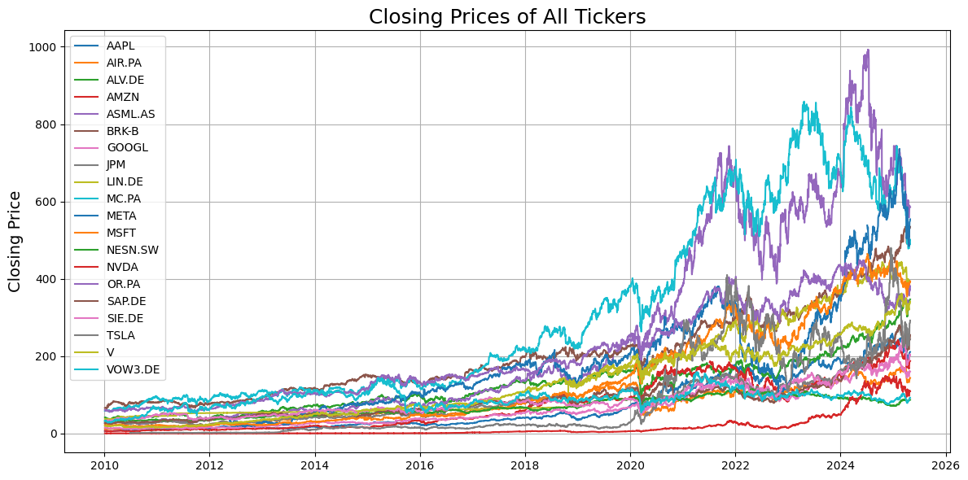
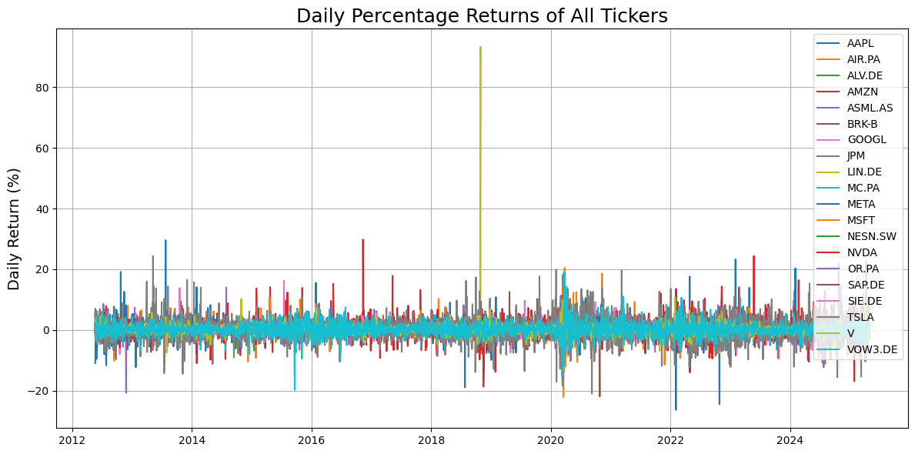
Data set
20 globally recognized companies across technology, finance, automotive, industrial, and consumer sectors.
Data was sourced from Yahoo Finance, covering the period from January 1, 2010 to March 31, 2025.

Slide 5
Baseline Models
We have used ARIMA and GARCH as our baseline model
ARIMA: Used for short‑term price forecasting by modeling autoregressive, integrated, and moving‑average components.
GARCH: Used for volatility forecasting by modeling time‑varying conditional variance (volatility clustering).
These two models serve as our foundational benchmarks for return and risk prediction.

Slide 6
ARIMA Model: Price Forecasting Workflow
Data Preparation
Applied a log transformation to stabilize variance.
Differenced the series (order d=1) to achieve stationarity.
Parameter Selection
Performed a grid search over AR order p and MA order q (with d =1 fixed).
Selected the (p, d, q) combination that minimized the Bayesian Information Criterion (BIC).
Model Fitting
Fitted the ARIMA model on the training set with the chosen parameters.
Validated performance on the hold‑out test set.
Evaluation
Implemented a rolling forecast on the test set, refitting the ARIMA model at each step.
Generated separate one-step‑ahead forecasts for each test point
Computed MAE and RMSE to assess accuracy.

Slide 7
GARCH Model: Volatility Forecasting Workflow
Data Preparation
Calculated daily log returns
Parameter Selection
Performed a grid search over GARCH orders p and q using the training data.
For each stock, selected the (p, q) pair that minimized the Bayesian Information Criterion (BIC).
Model Fitting
Fitted the GARCH model on the training set with the chosen parameters.
Validated performance on the hold‑out test set.
Forecasting & Evaluation
Implemented a rolling forecast on the test set, refitting the GARCH model at each step.
Forecasted one-step-ahead Volatility for each test point.
Computed MAE and RMSE to assess accuracy.

Slide 8
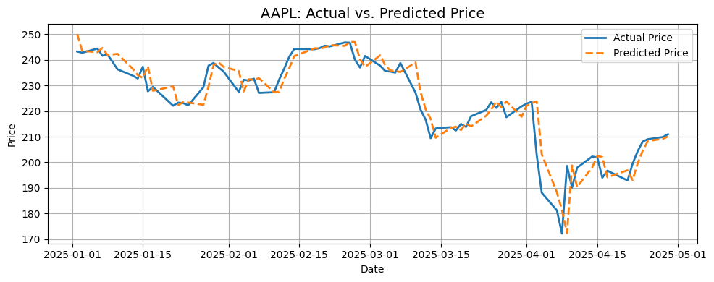
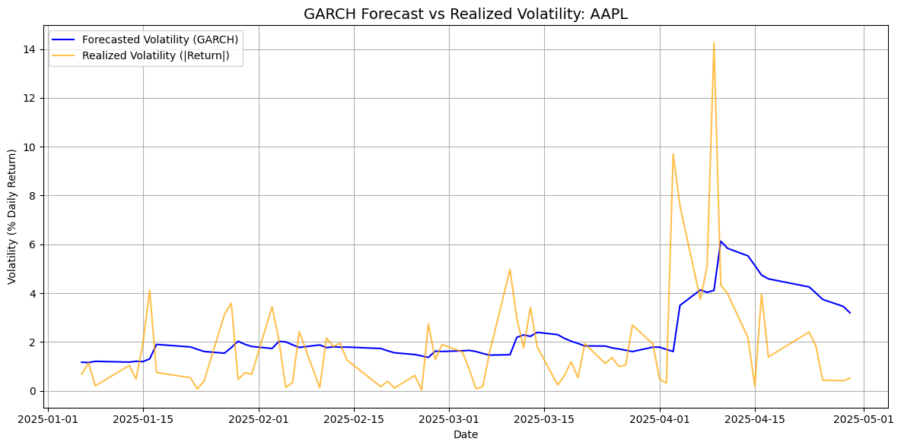
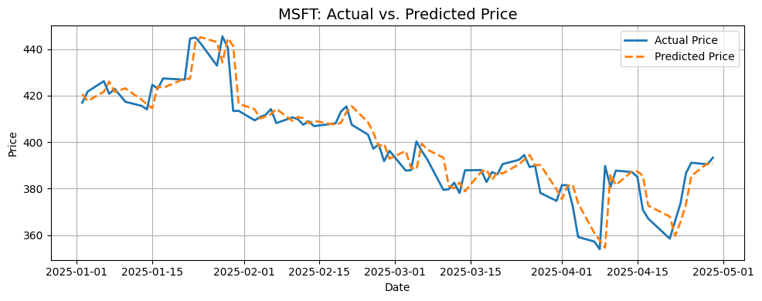
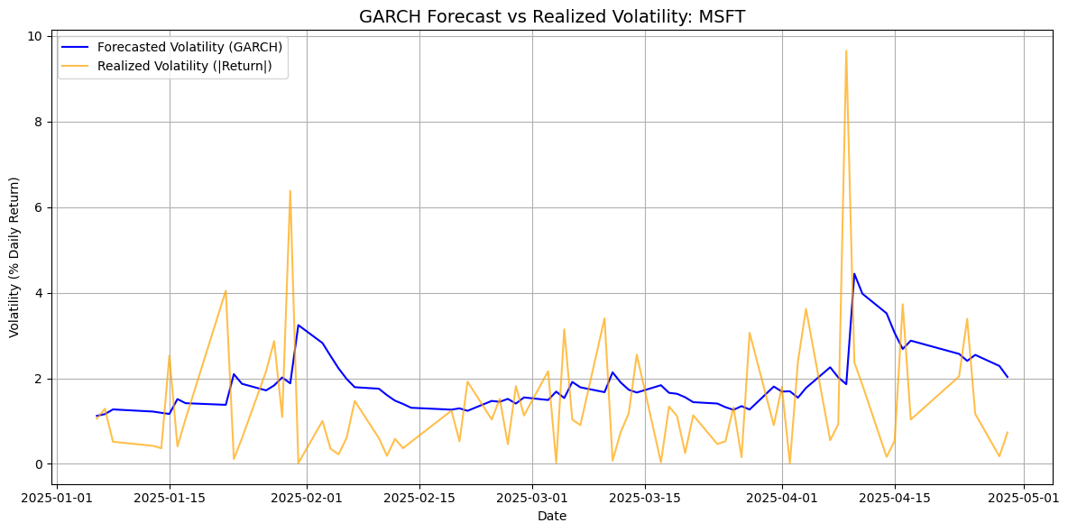
Forecasting Performance: ARIMA & GARCH Actual vs. Predicted

Slide 9
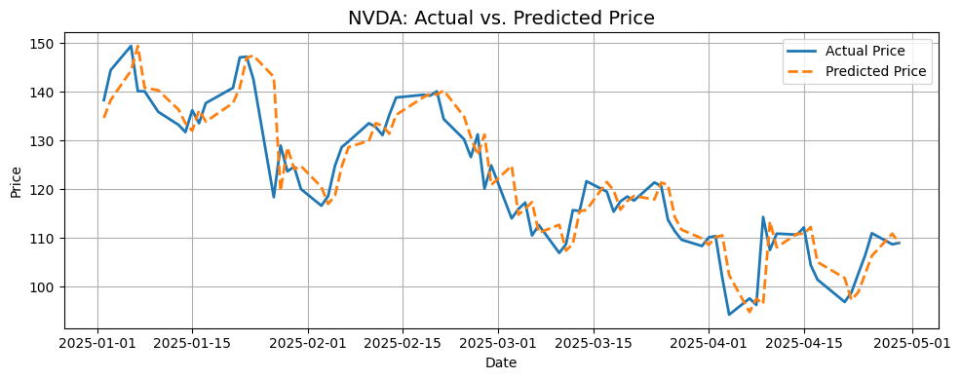
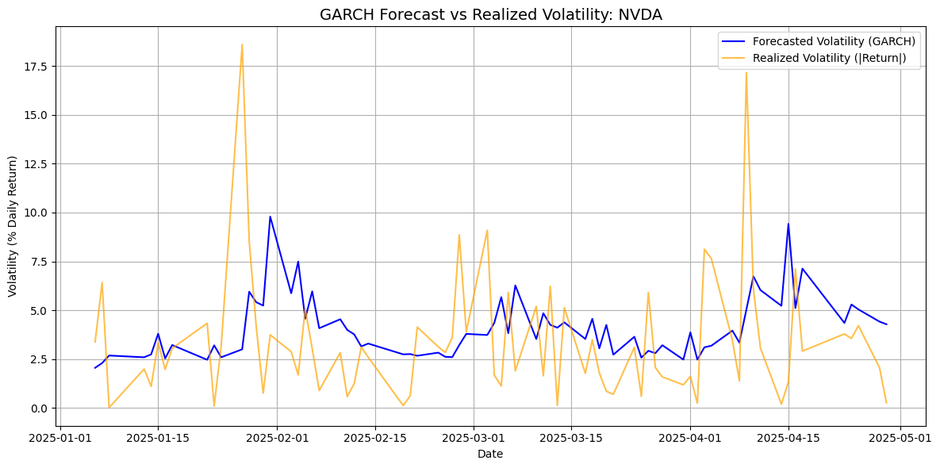
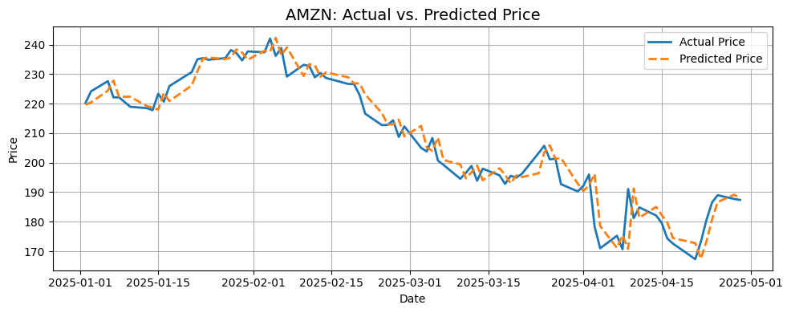
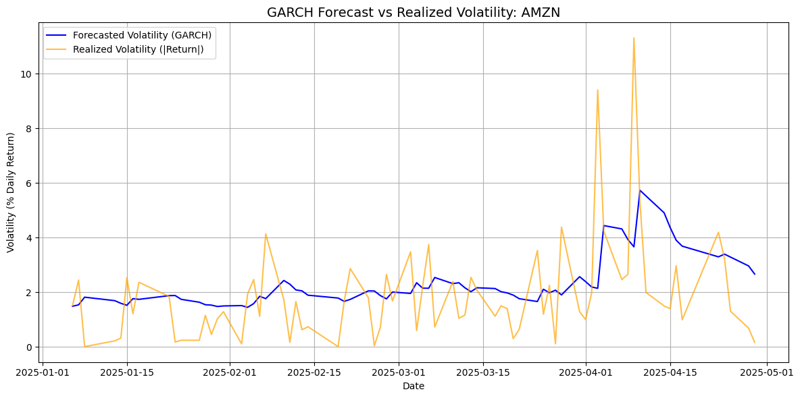
Forecasting Performance: ARIMA & GARCH Actual vs. Predicted

Slide 10
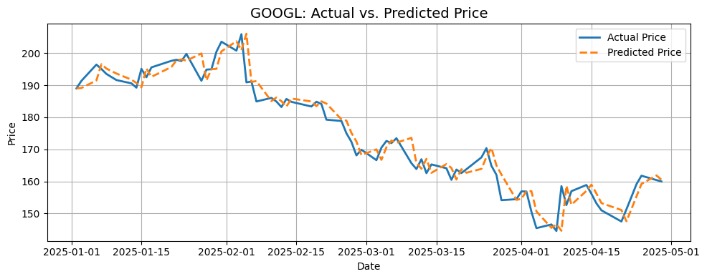
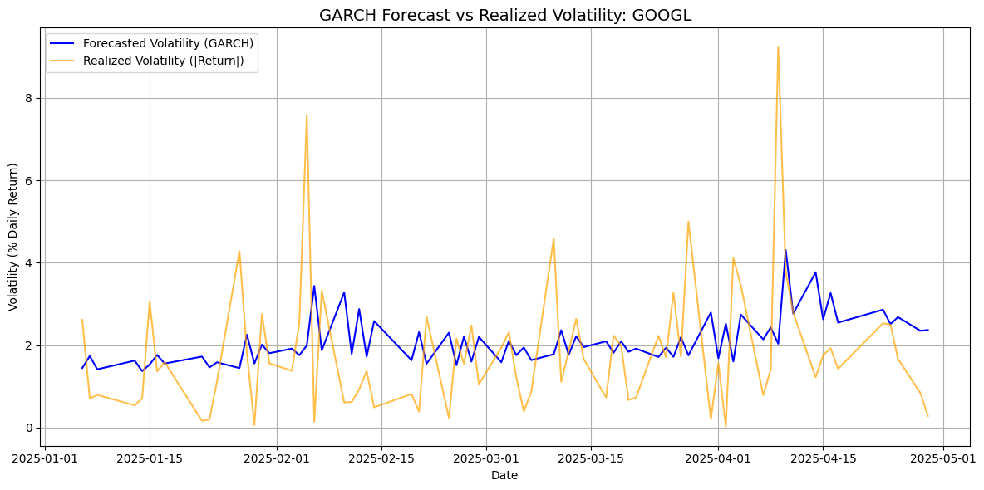
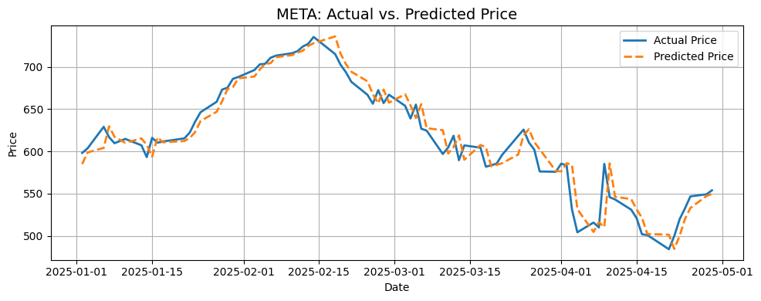
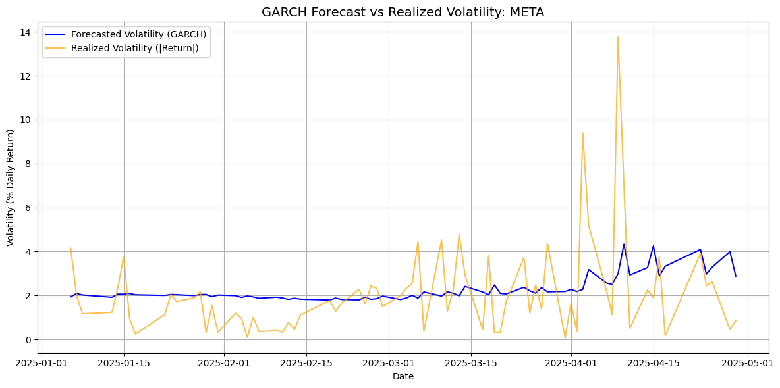
Forecasting Performance: ARIMA & GARCH Actual vs. Predicted

Slide 11
Stock Forecast Accuracy: MAE & RMSE for ARIMA & GARCH
ARIMA
GARCH
Stock MAE RMSE
AAPL 4.091392 5.996919
MSFT 5.508590 7.950594
NVDA 4.018604 5.543244
AMZN 3.804370 5.093458
GOOGL 3.076819 4.055473
META 12.541686 17.143786
TSLA 11.530044 14.922781
BRK‑B 5.296579 7.986166
JPM 3.527638 5.121703
V 3.797573 5.794724
SAP.DE 3.971100 5.516563
SIE.DE 3.878375 5.506522
ALV.DE 3.551259 5.233282
VOW3.DE 1.455966 1.924458
LIN.DE 3.831369 5.551702
MC.PA 9.869994 14.028798
OR.PA 4.862815 6.108709
AIR.PA 2.631216 3.548107
ASML.AS 13.1484 17.075604
NESN.SW 0.8481 1.222098
Stock MAE RMSE
AAPL 1.522514 2.228308
MSFT 1.297048 1.714305
NVDA 2.665115 3.676411
AMZN 1.351453 1.880892
GOOGL 1.270257 1.742215
META 1.386151 2.079603
TSLA 2.400147 3.605987
BRK‑B 0.910566 1.269367
JPM 1.201607 1.626328
V 1.057909 1.459868
SAP.DE 1.234072 1.642614
SIE.DE 1.504709 1.943803
ALV.DE 0.889942 1.170593
VOW3.DE 1.168535 1.414243
LIN.DE 1.060477 1.213820
MC.PA 1.344698 1.796585
OR.PA 0.793083 0.984570
AIR.PA 1.153930 1.460713
ASML.AS 1.414906 1.832806
NESN.SW 0.801679 1.136269

Slide 12
Tree-Based Ensemble Models

Slide 13
XGBoost Model
Data Preprocessing for XGBoost
Feature engineering:
returns, volatility, dollar volume, lags
Target defined:
5-day future return
Data cleaning:
handled missing values & short series
XGBoost Model Architecture:
Input: return-based features (lags, volatility, volume)
Target: 5-day forward return
TimeSeriesSplit with 3 folds (preserves temporal order)
RobustScaler for outlier-resistant normalization
Hyperparameters: 500 trees, LR = 0.05, max depth = 6

Slide 14
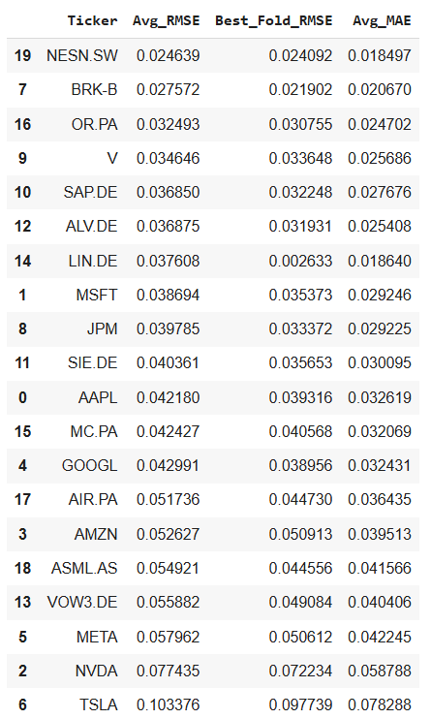
XGBoost results
Average RMSE: 0.046516
Average MAE: 0.03421
Better results on stable stocks, higher error on volatile ones (e.g., TSLA, NVDA)

Slide 15
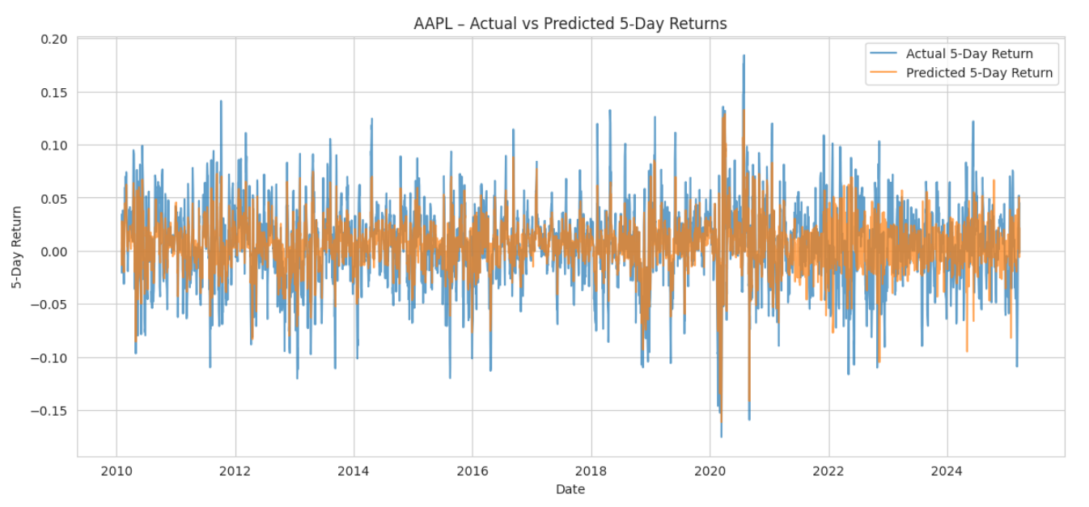
XGBoost results

Slide 16
LightGBM
Preprocessing :
Applied same preprocessing pipeline as XGBoost
Model architecture: Key Parameters
n_estimators = 500 (number of boosting rounds) learning_rate = 0.05 max_depth = 6

Slide 17
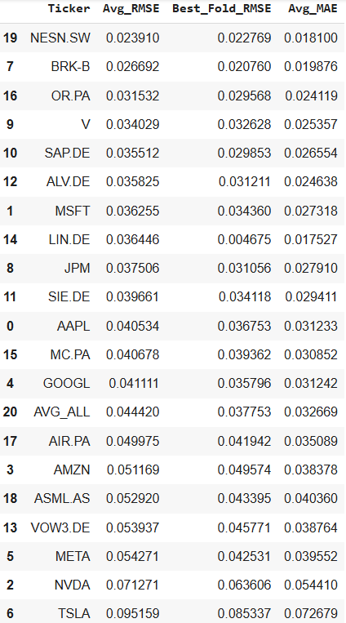
LightGBM results
XGBoost
Average RMSE: 0.046516
Average MAE: 0.03421
LightGBM
Average RMSE: 0.04592
Average MAE: 0.03406

Slide 18
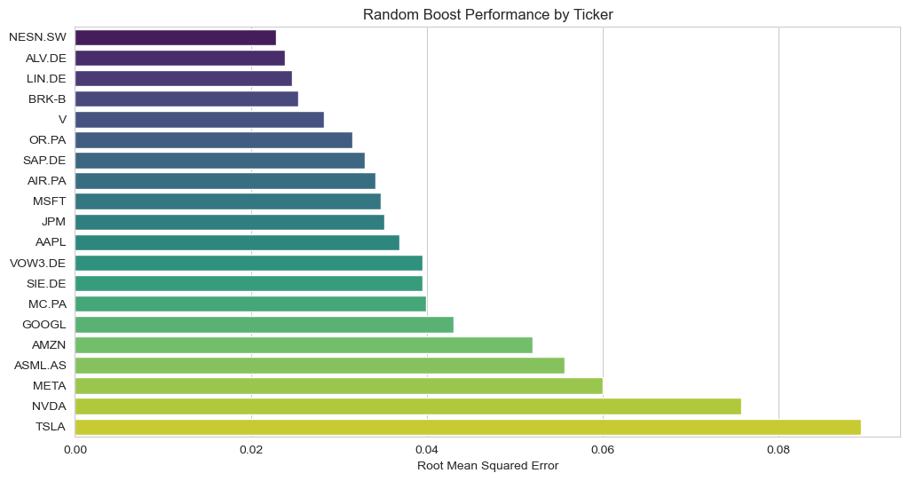
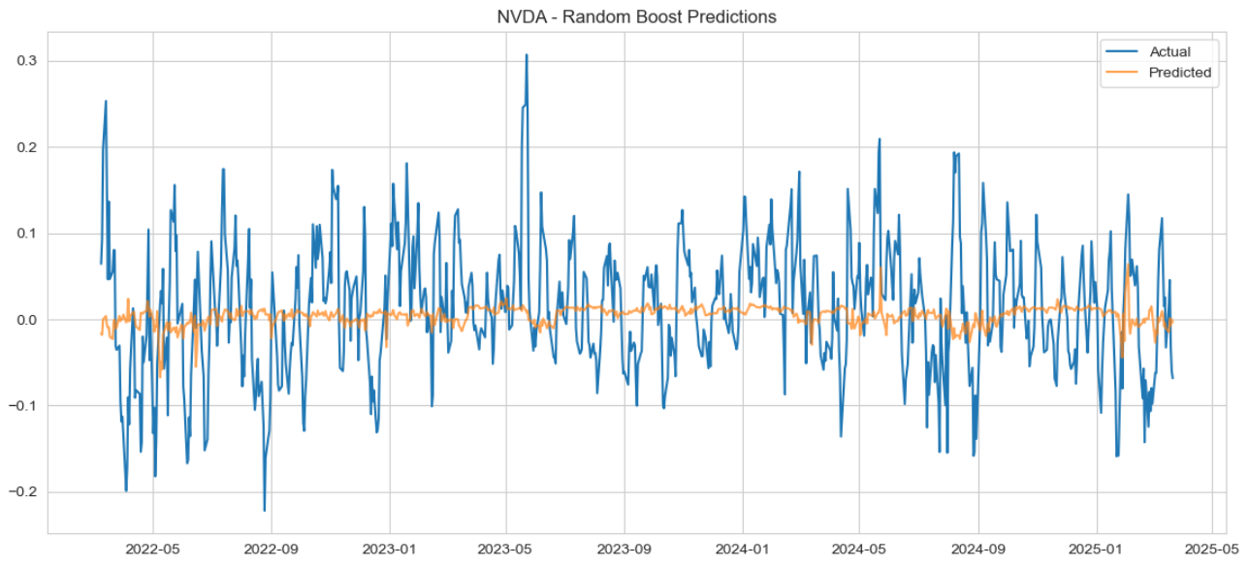
Random Boost

Slide 19
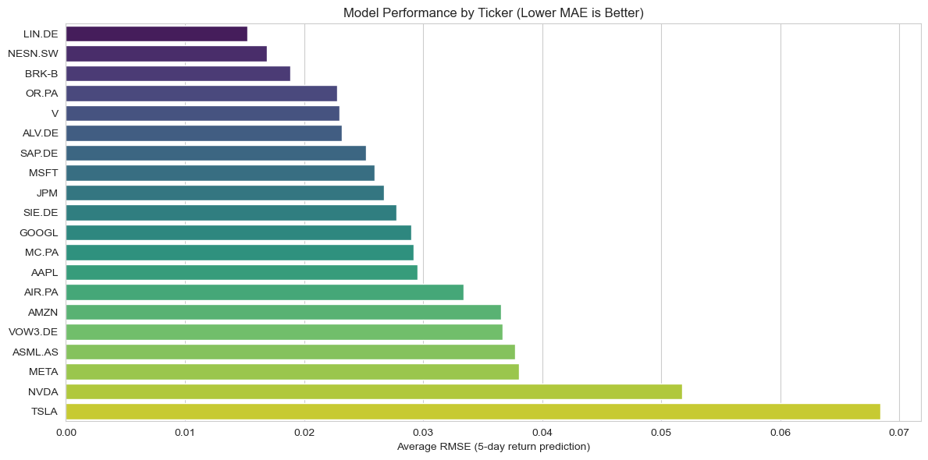
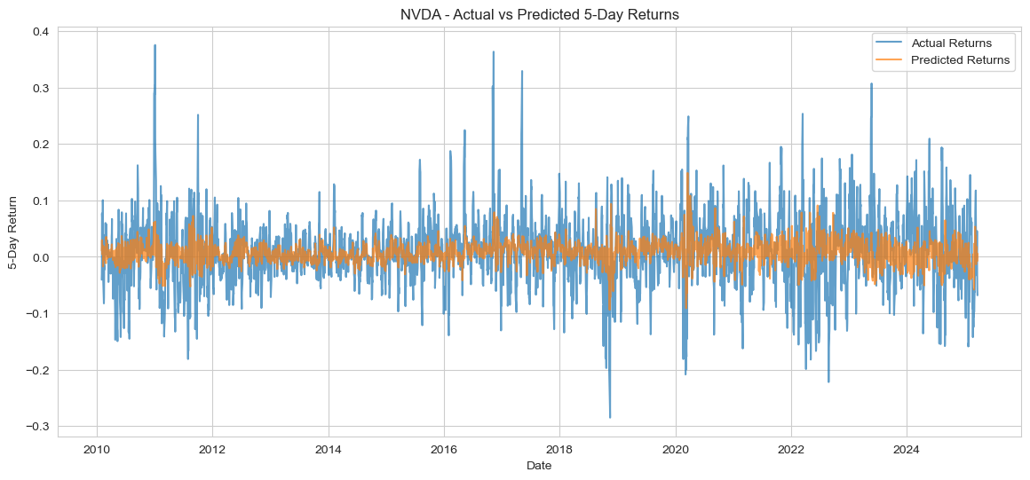
Cat Boost

Slide 20
Recurrent Neural Networks

Slide 21
RNN Model
Data Preprocessing for RNN:
Calculated daily returns, 21-day volatility, and 5-day dollar volume
Created lagged return features (up to lag 5)
Defined the 5-day return as the prediction target
Constructed input sequences of length 10 for RNN training
RNN architecture:
SimpleRNN(32, activation='tanh') followed by Dense(1)
Optimizer: Adam | Loss: MSE
EarlyStopping on validation loss (patience=5)
Trained for up to 50 epochs, batch size = 32
Separate model trained for each stock

Slide 22
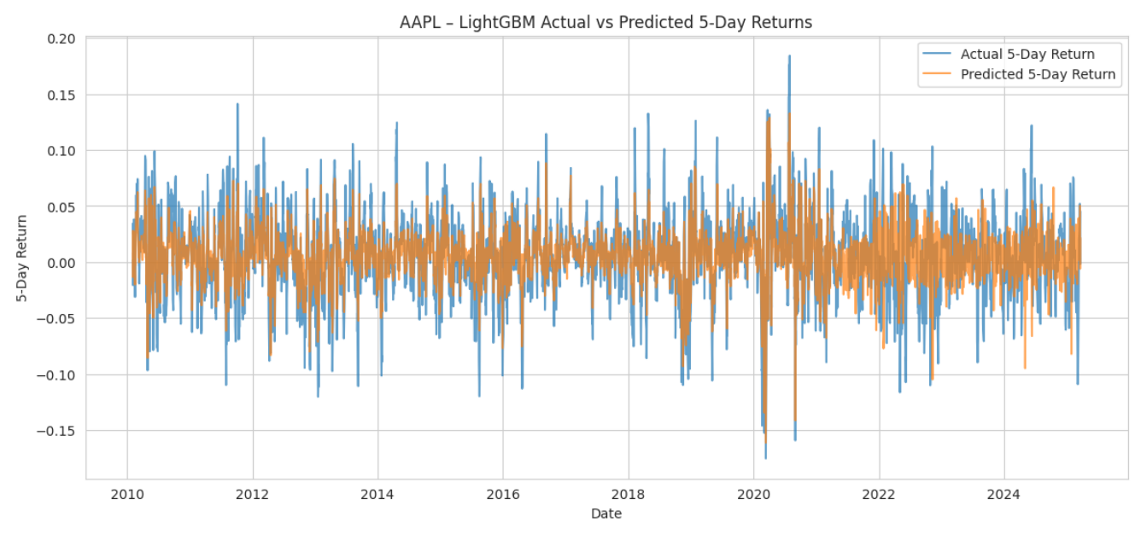
RNN results
Average RMSE: 0.046516
Average MAE: 0.03421

Slide 23
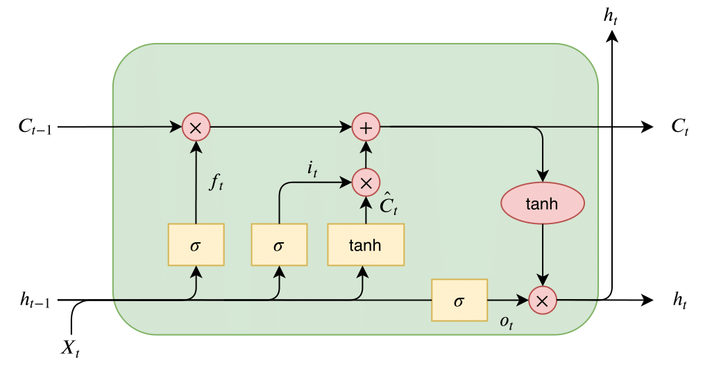
LSTM (Long Short-Term Memory)
Cell State (C): Memory of the network. Hidden State (h): Output at each time step. Forget Gate: Decides what to forget. Input Gate: Decides what to add.,Output Gate: Decides what to output
Architecture of lstm for this project

Slide 24
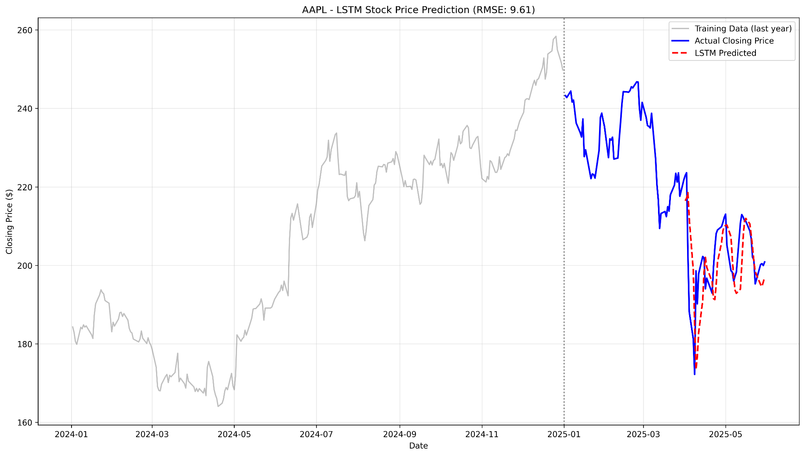
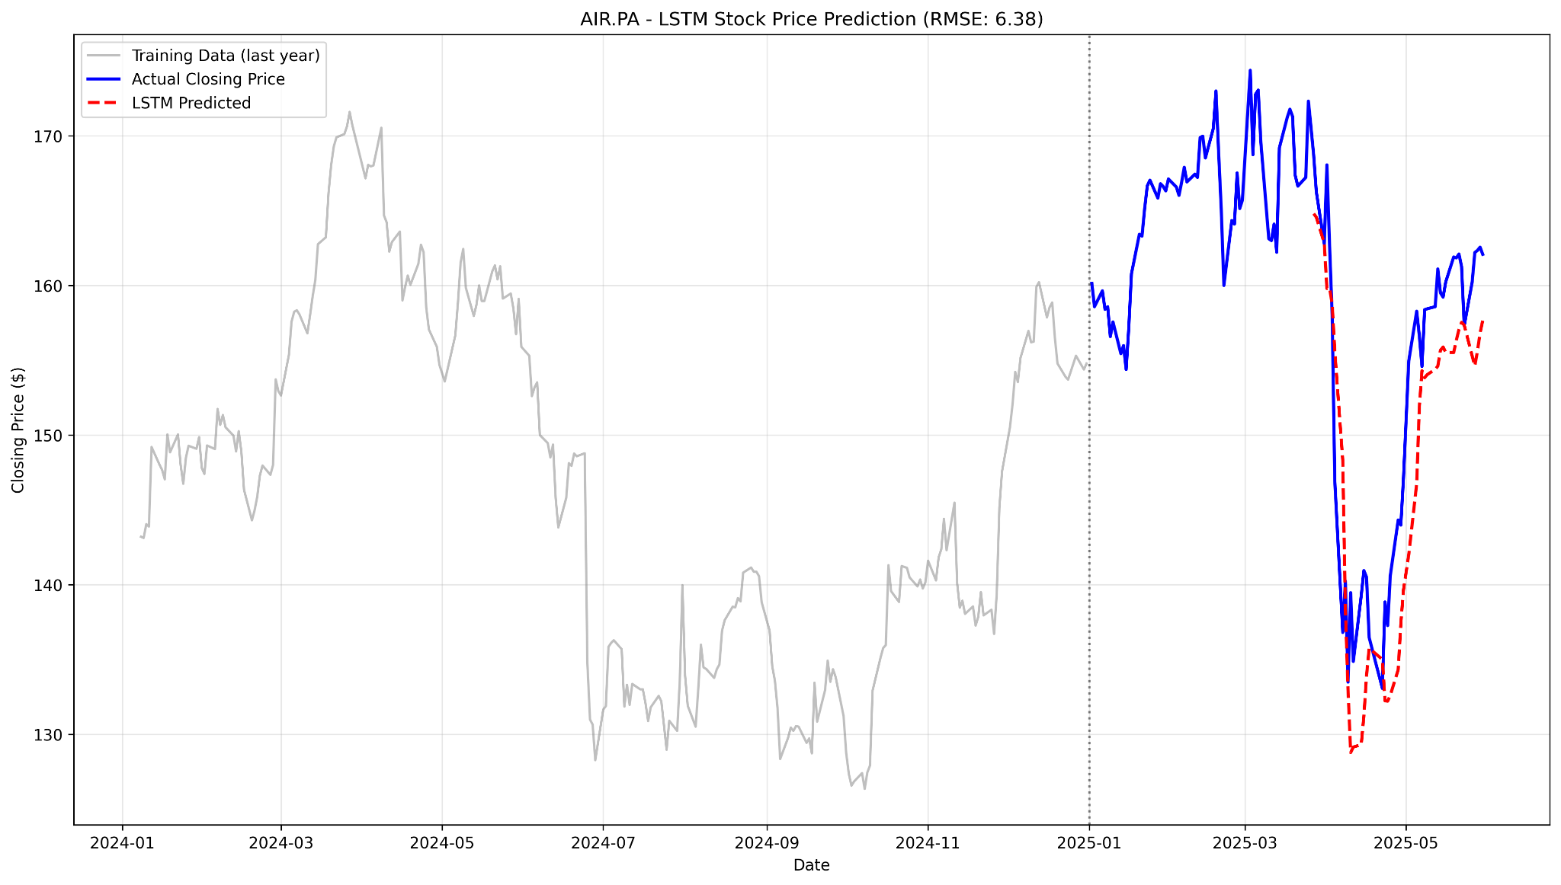
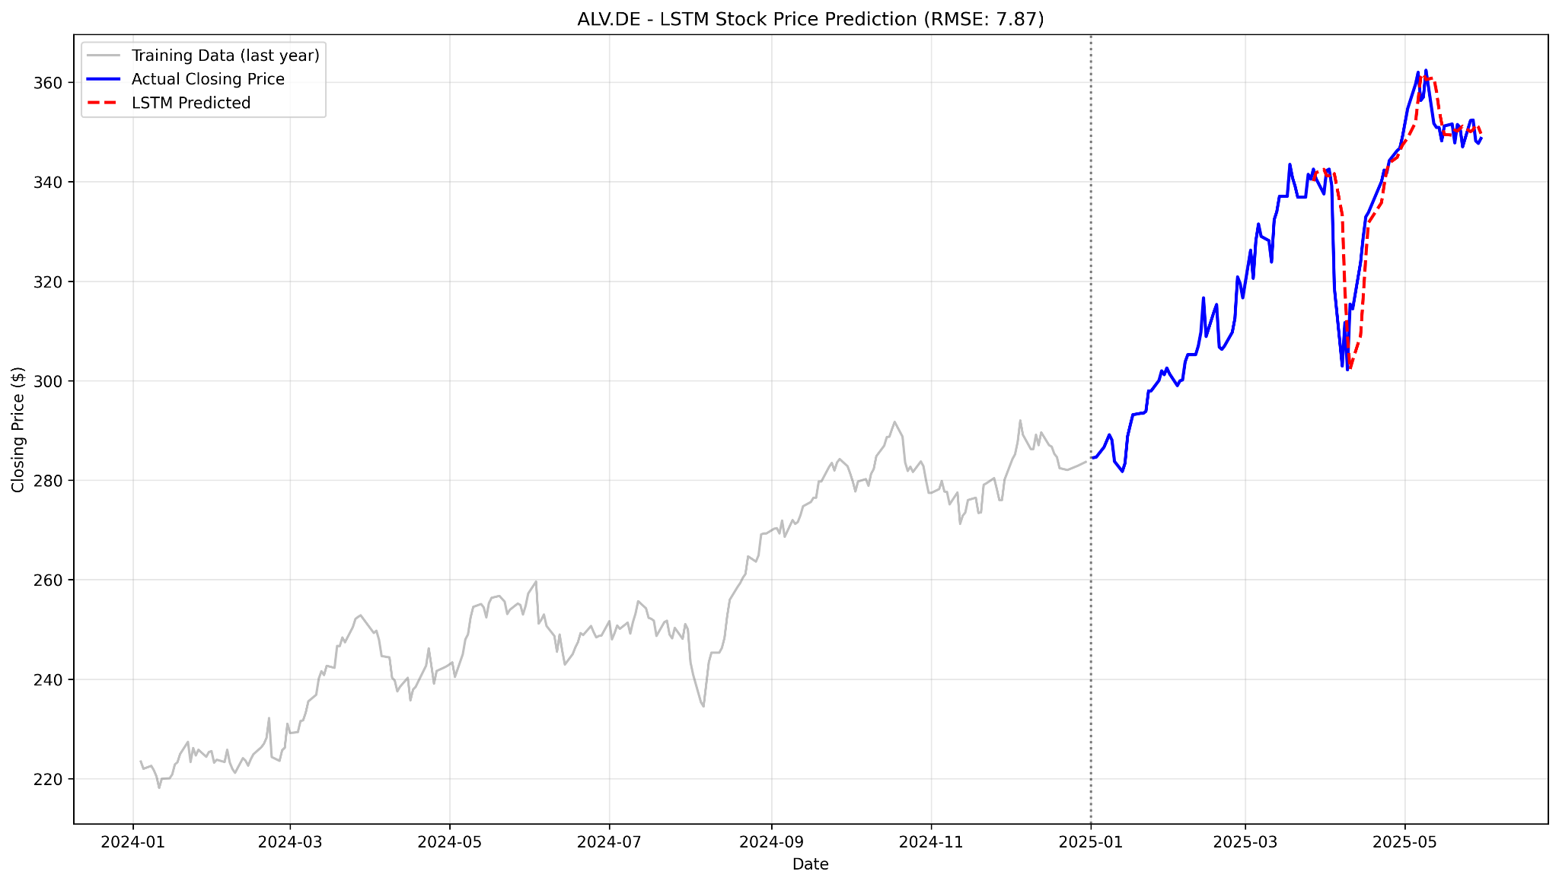
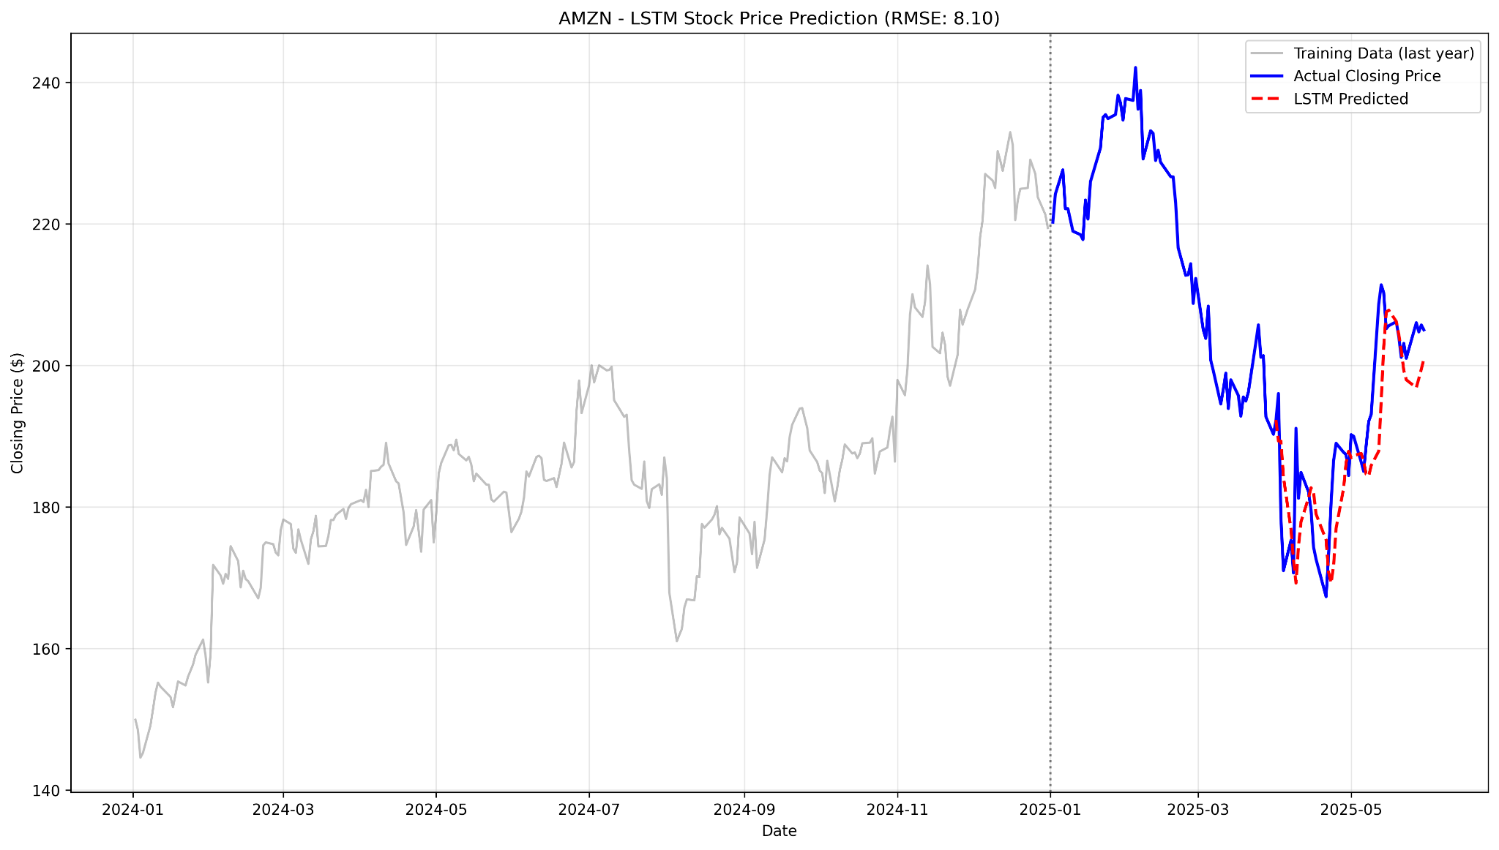
LSTM (Long Short-Term Memory)

Slide 25
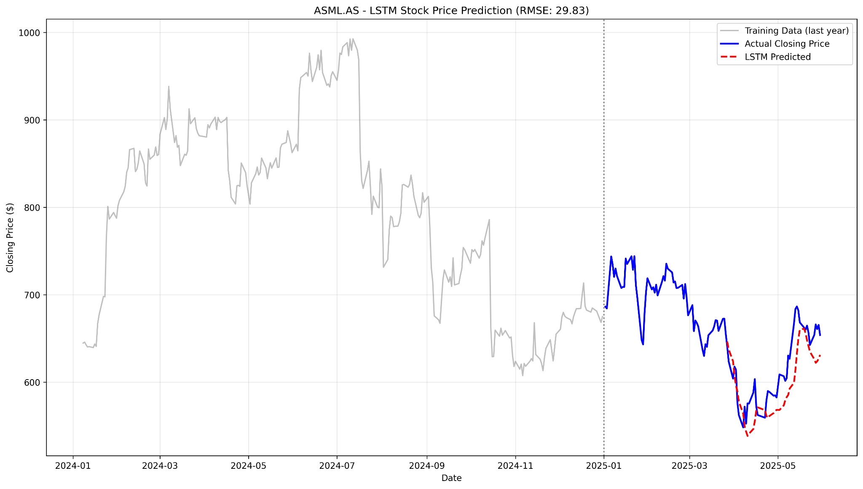
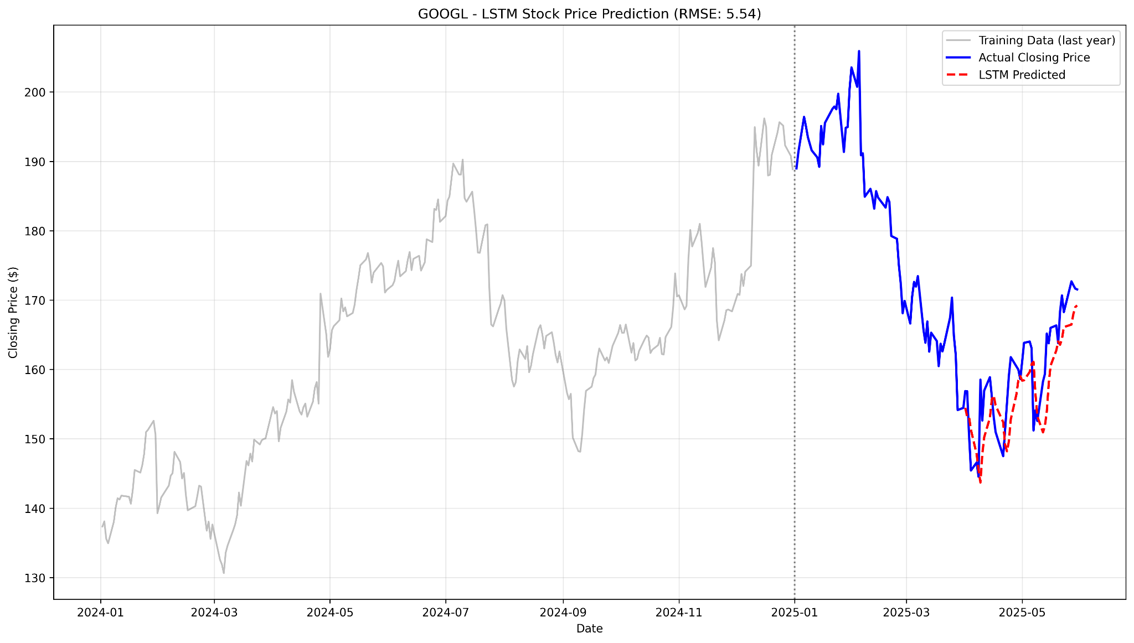
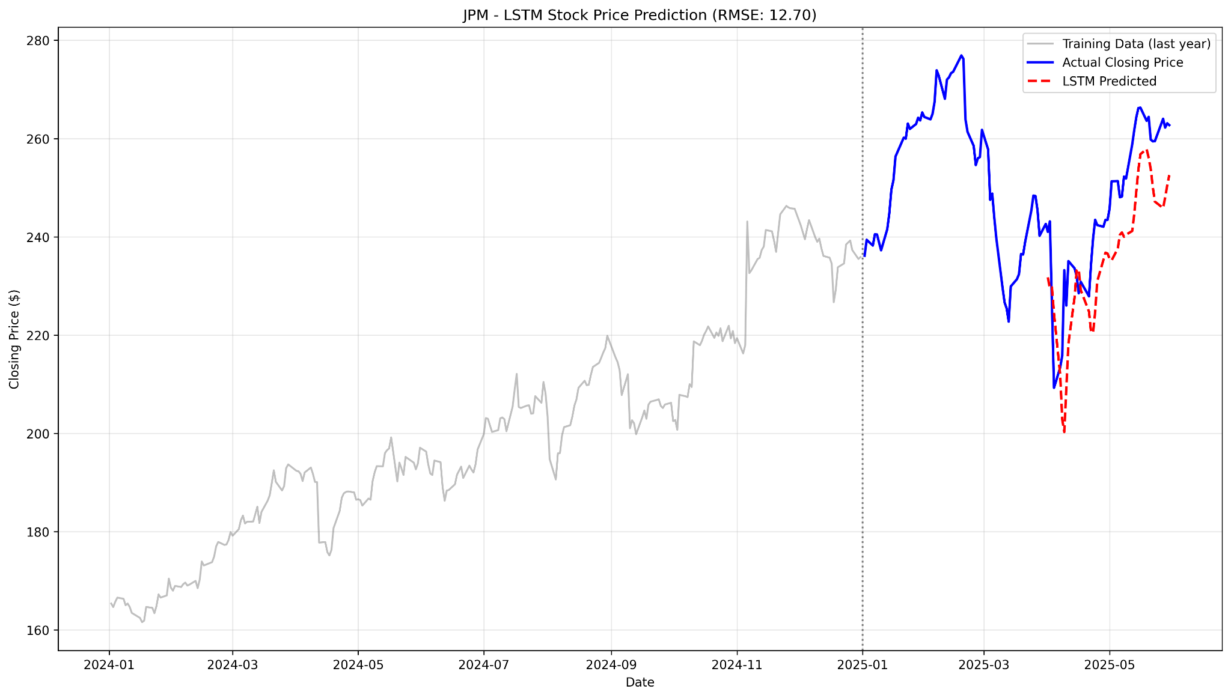
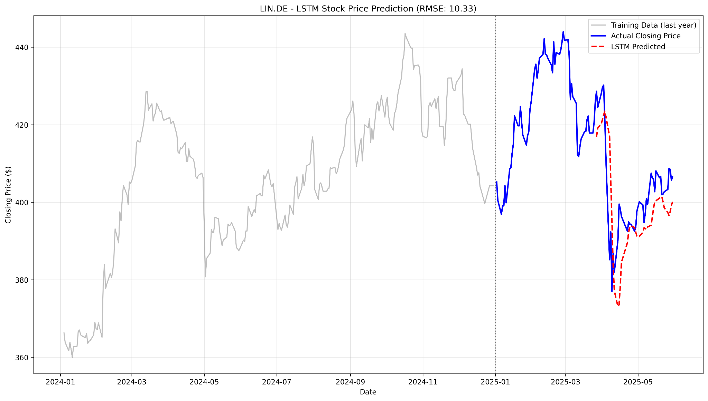

Slide 26
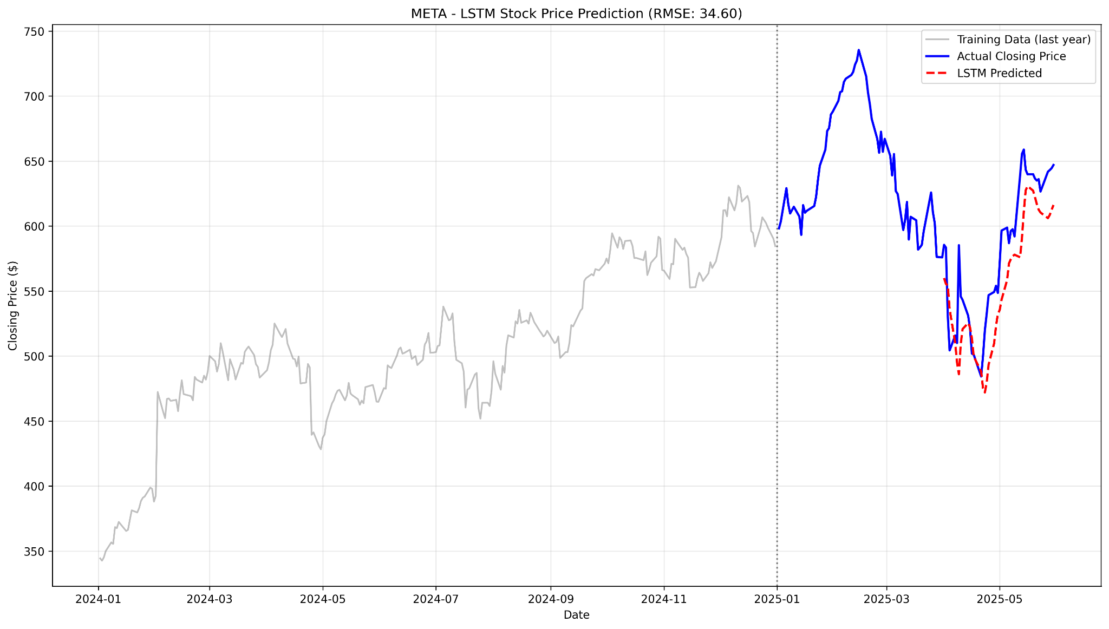
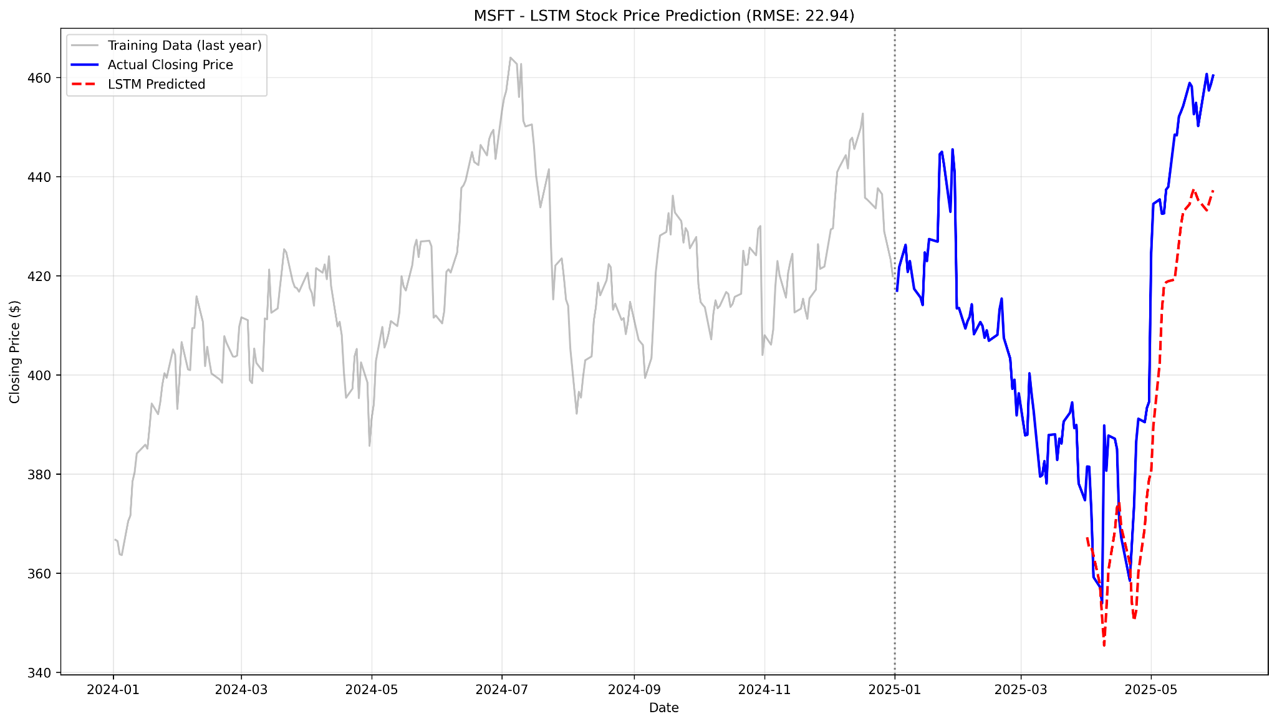
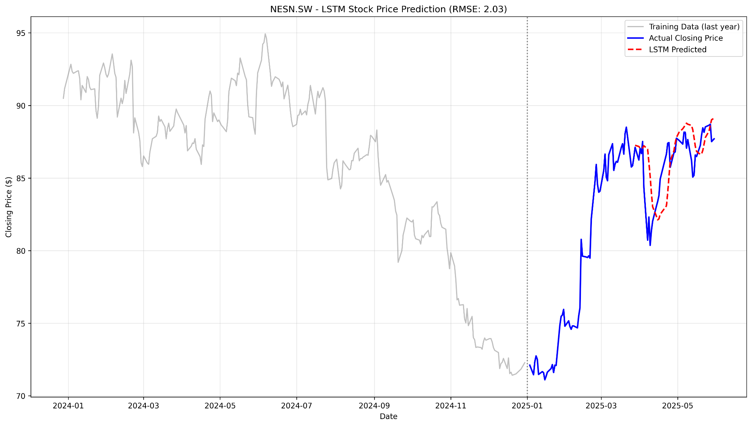
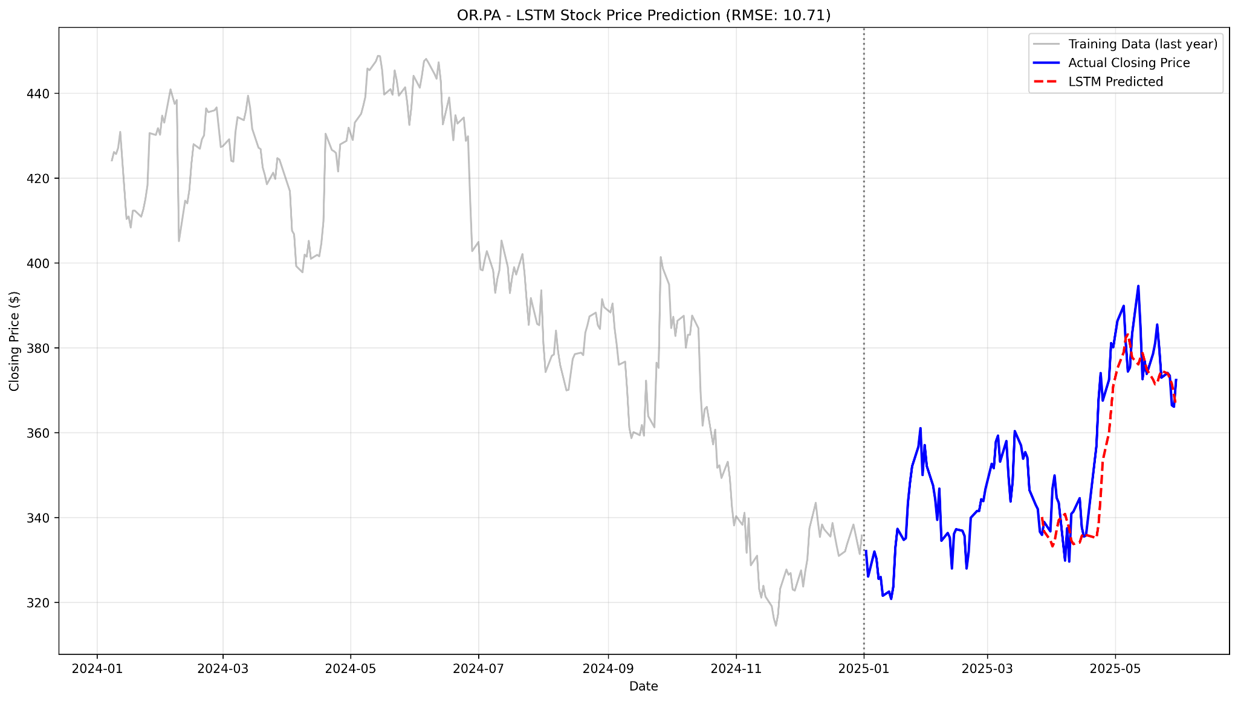

Slide 27
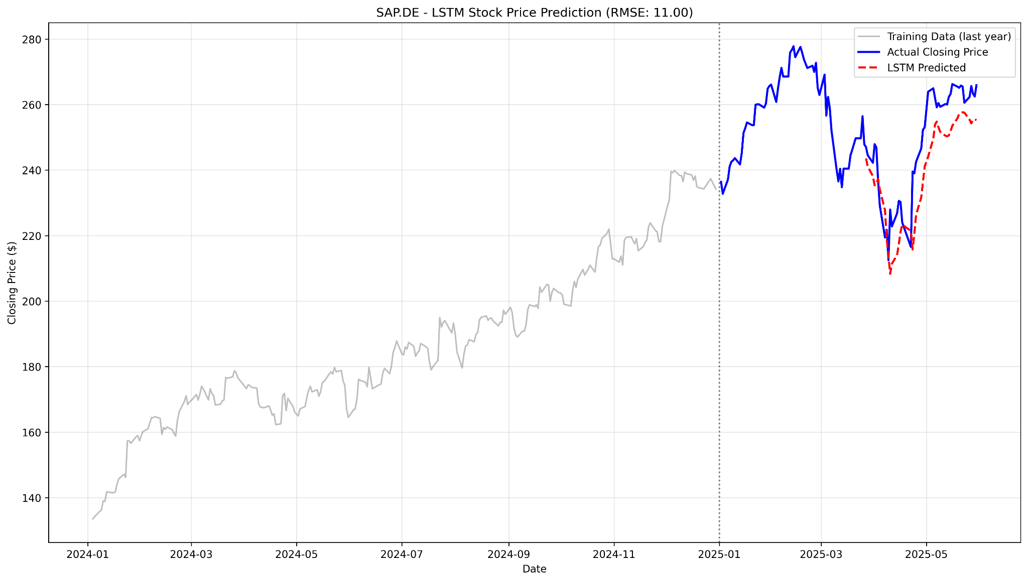
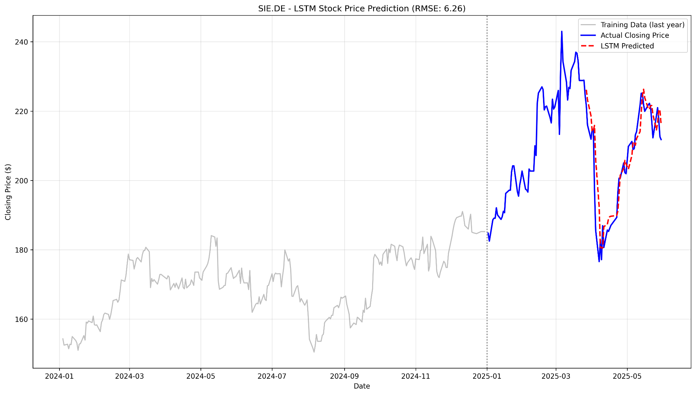
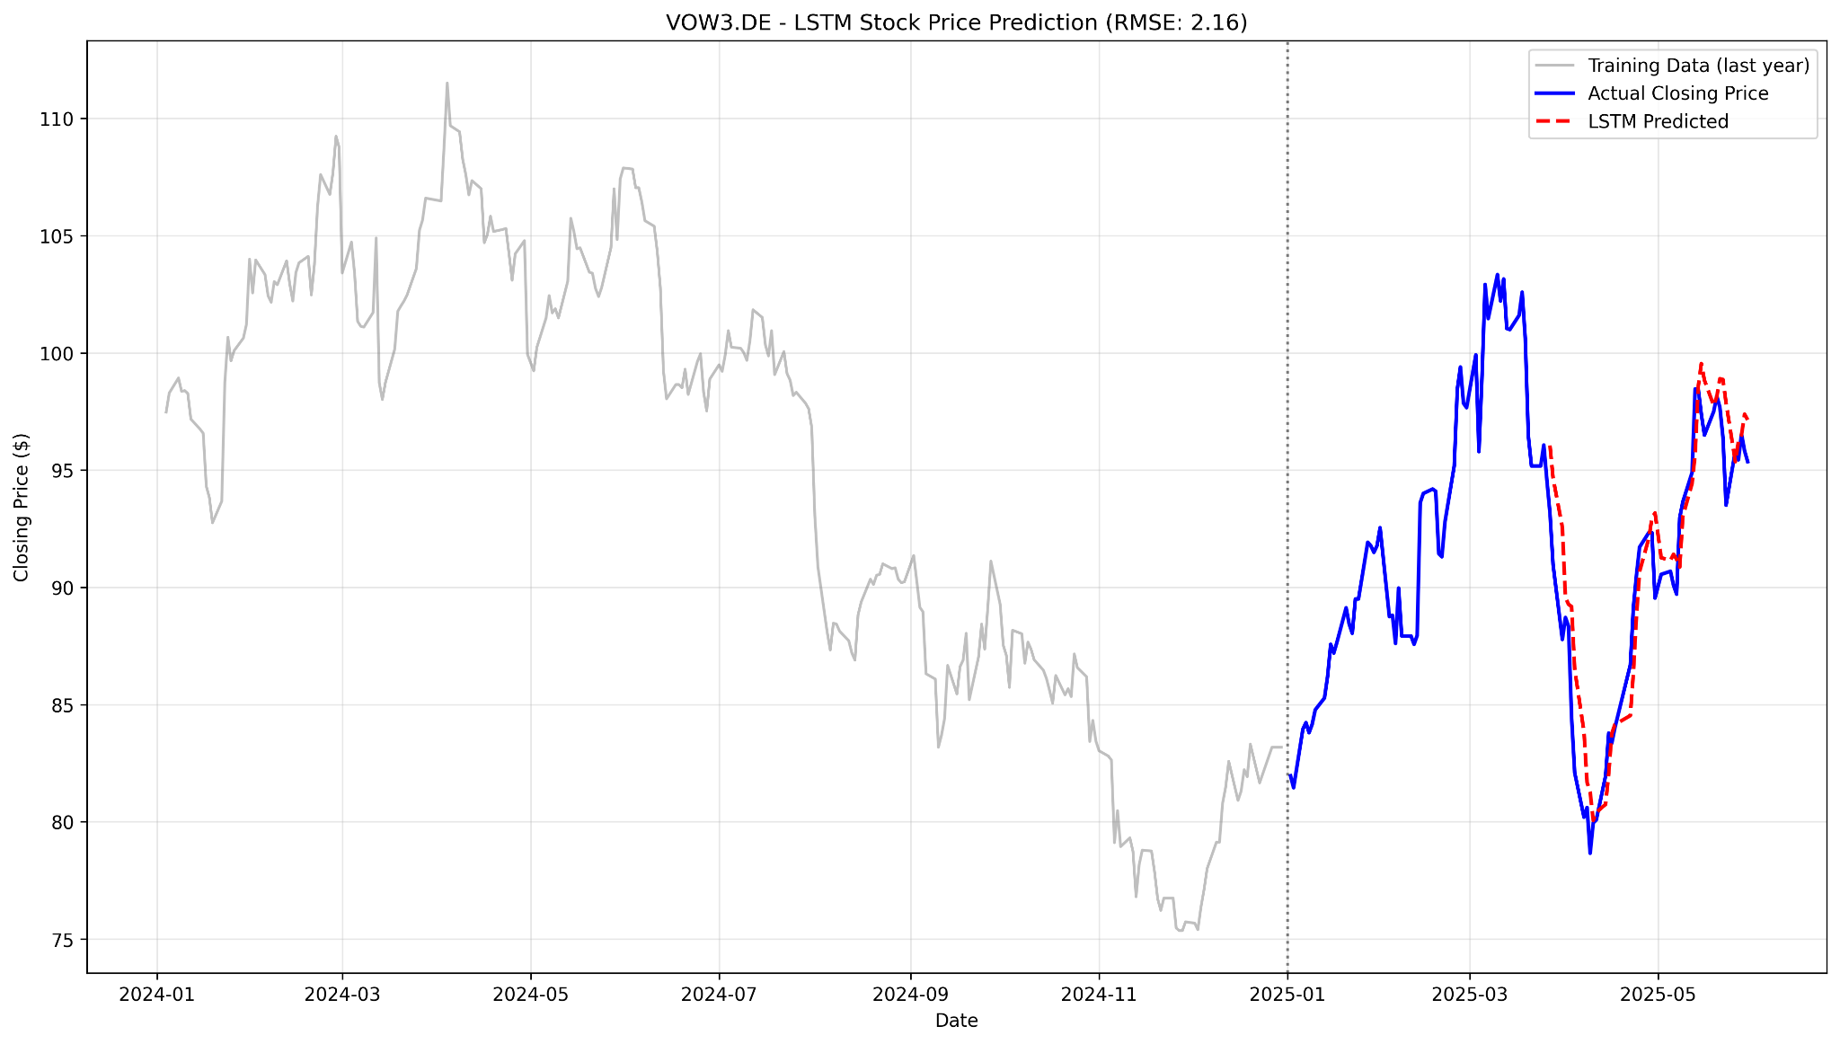
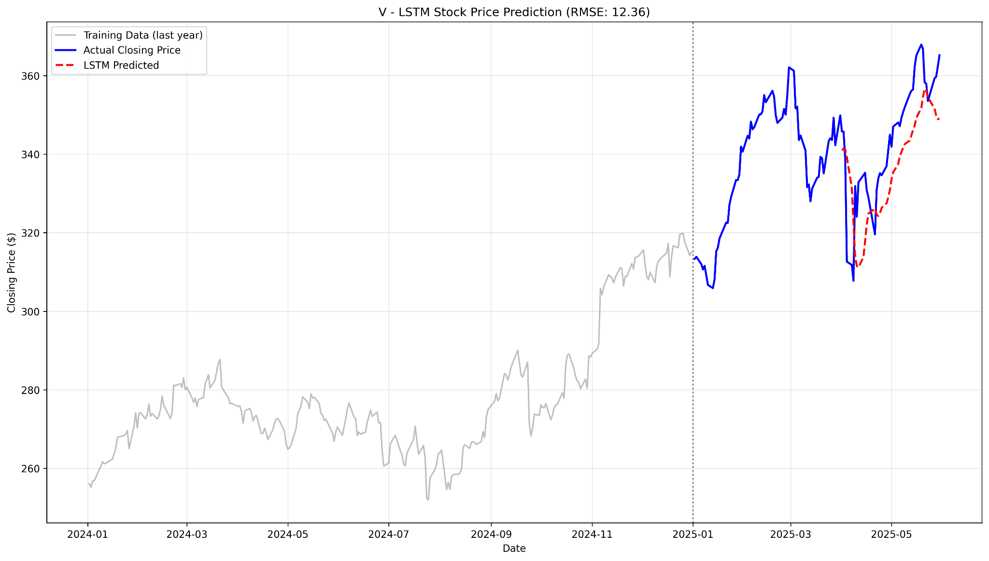

Slide 28
Specialized Time Series Models

Slide 29
N-BEATS Model
Data Preprocessing for N-BEATS:
Designed for univariate target forecasting using past features
Used a 30-day input window to form fixed-length sequences
Built custom PyTorch dataset and dataloader
Applied 3-fold time-series cross-validation
N-BEATS architecture:
Deep feedforward network for univariate time series forecasting
Uses stacked blocks (Trend & Seasonality) to model different signal components
Each block outputs a backcast (residual) and a forecast
Fully connected layers, no recurrence or convolution
Allows interpretable decomposition of predictions

Slide 30
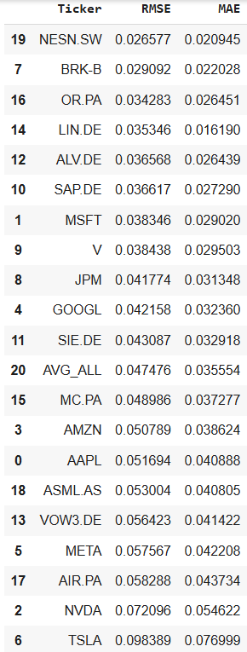
N-BEATS results
Average RMSE: 0.04546
Average MAE: 0.03551

Slide 31
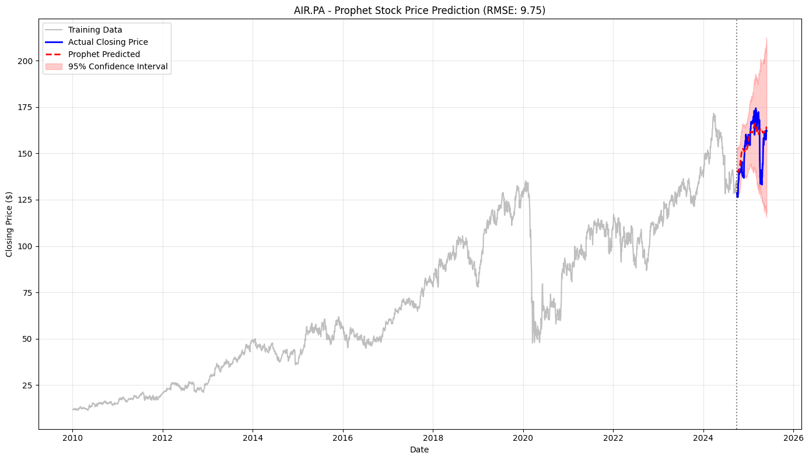
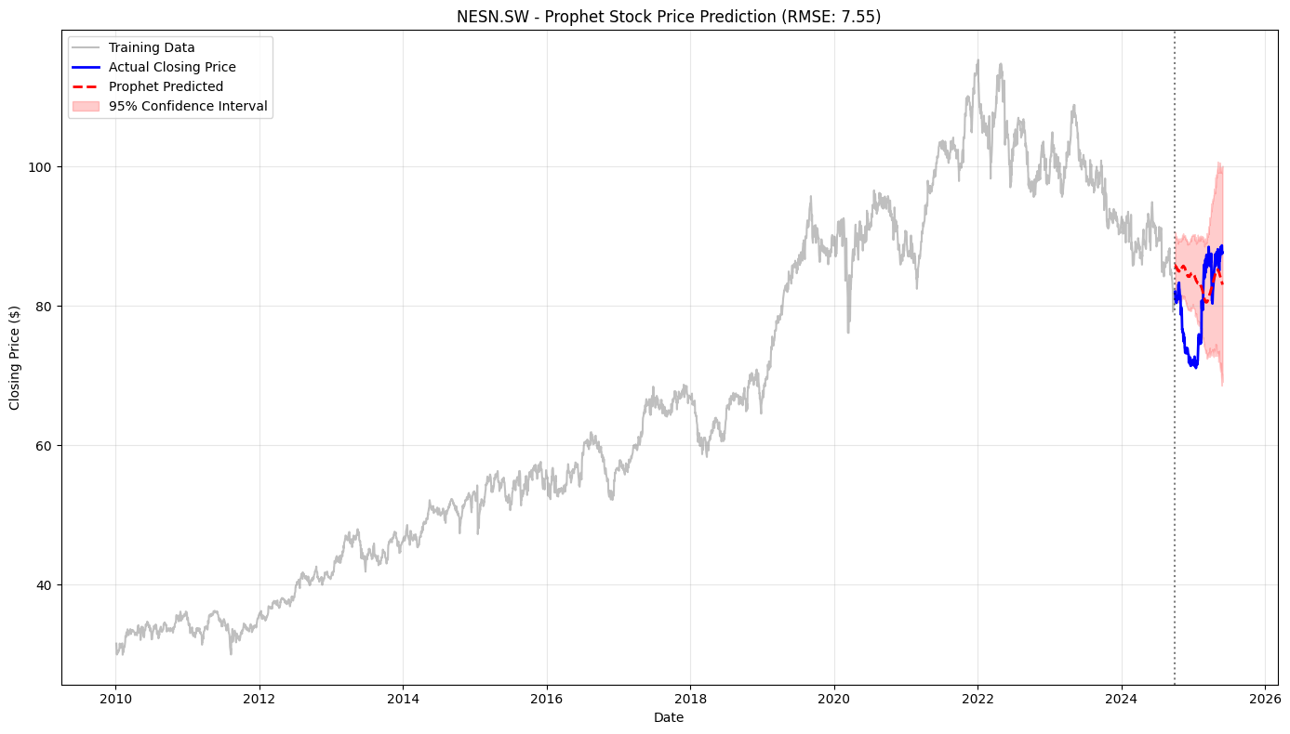
Prophet model- by Facebook (Meta)
Ease of use, scalability, and ability to handle: Seasonality,Holidays and special events, Missing data, Outliers, and Trend changes (changepoints)

Slide 32
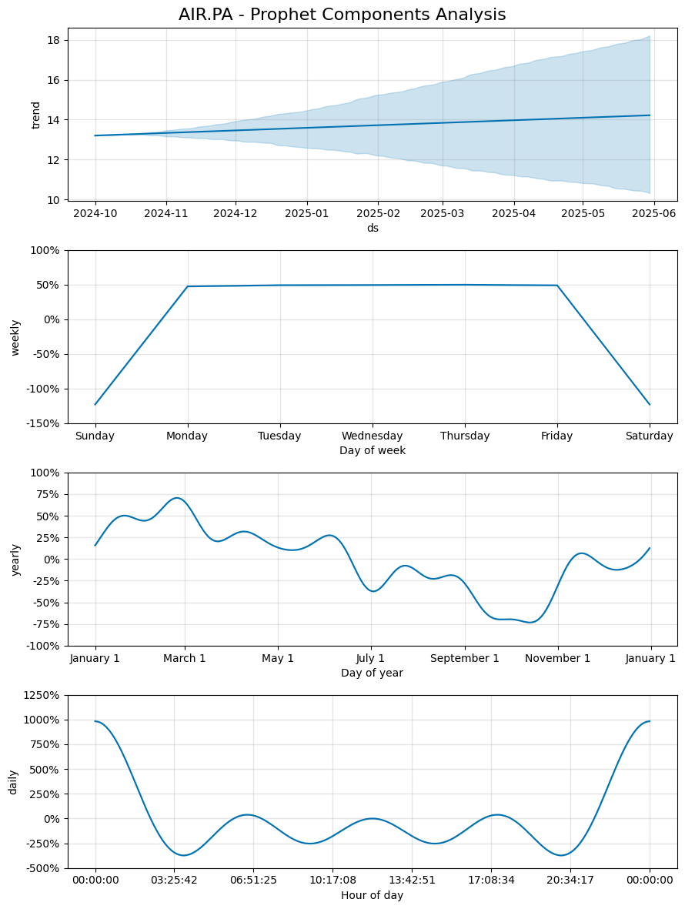
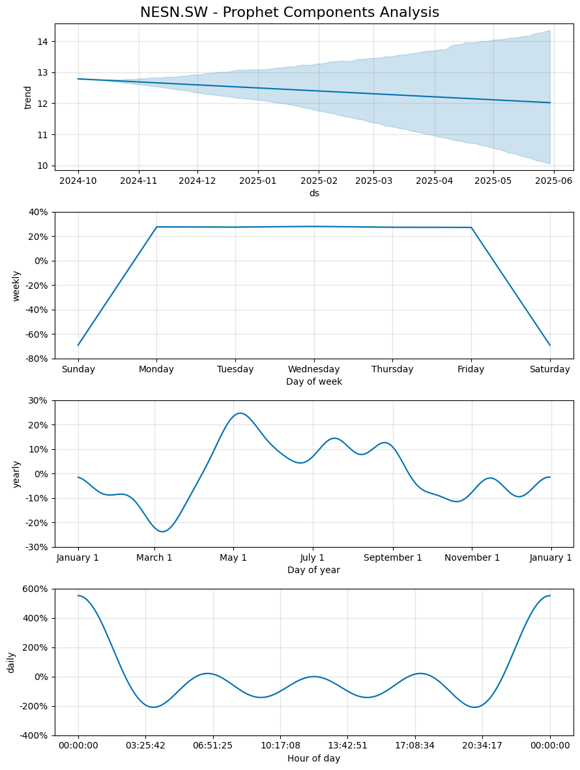
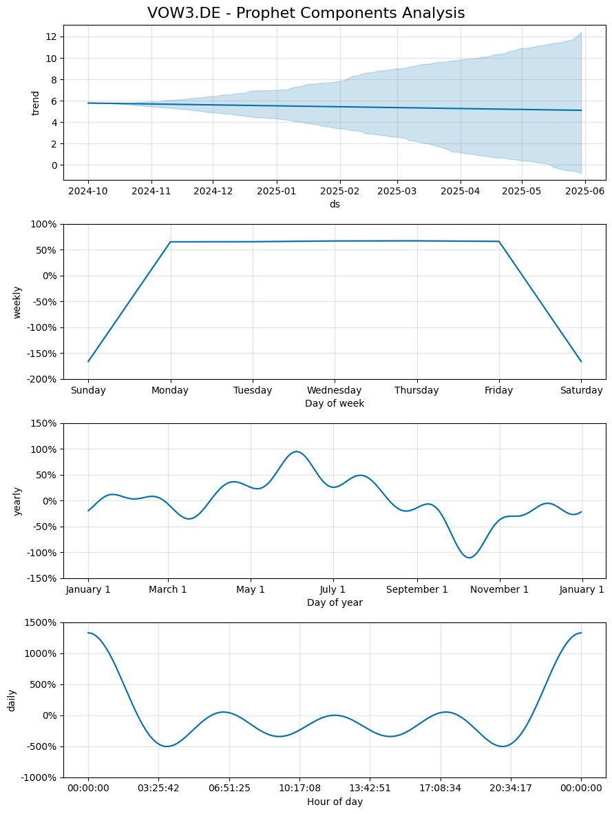

Slide 33
Model Comparison Overview

Slide 34
Model | Strength | weakness | Total avg MAE | Total Avg RMSE
ARIMA | Simple, interpretable | Needs stationarity, struggles with non-linear patterns | 5.5501 | 7.4927
GARCH | Captures volatility | poor at predicting levels, complex tuning | 1.3264 | 1.7532
XGBoost | Robust for tabular data | Requires feature engineering for temporal data | 0.03421 | 0.04652
LightGBM | Faster than XGBoost, scalable | Similar limitations as XGBoost | 0.03406 | 0.04592
CatBoost | Better with categorical features | Computationally intensive | 0.03536 | 0.0458
RNN | Captures sequential patterns | Struggles with long-term dependencies | 0.03421 | 0.04651
LSTM | Handles longer sequences | Requires significant data & tuning | 8.47320 | 11.4300
Prophet | Interpretable, built in seasonality | Less flexible in complex nonlinear patterns | 58.0604 | 63.8998
N-BEATS | Learns patterns end-to-end, flexible | Computationally heavy | 0.03551 | 0.0454

Slide 35
Conclusion
Among all models tested, LightGBM achieved the best overall performance, with the lowest MAE and RMSE, closely followed by XGBoost, CatBoost, and N-BEATS. These models outperformed traditional methods like ARIMA and GARCH, as well as deep learning models such as LSTM and RNN. This suggests that gradient boosting methods are highly effective for forecasting stock returns in this context.

Slide 36
Thank you!

